Slide 1

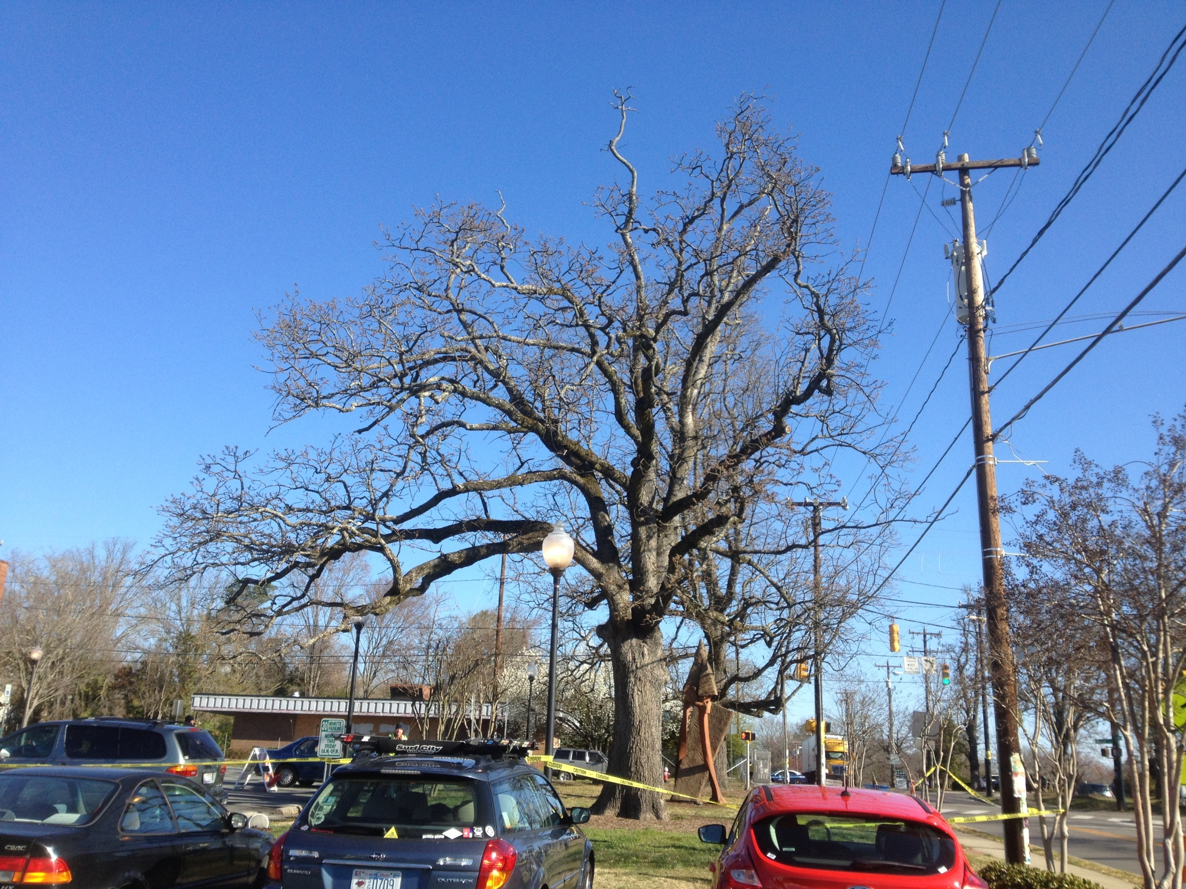
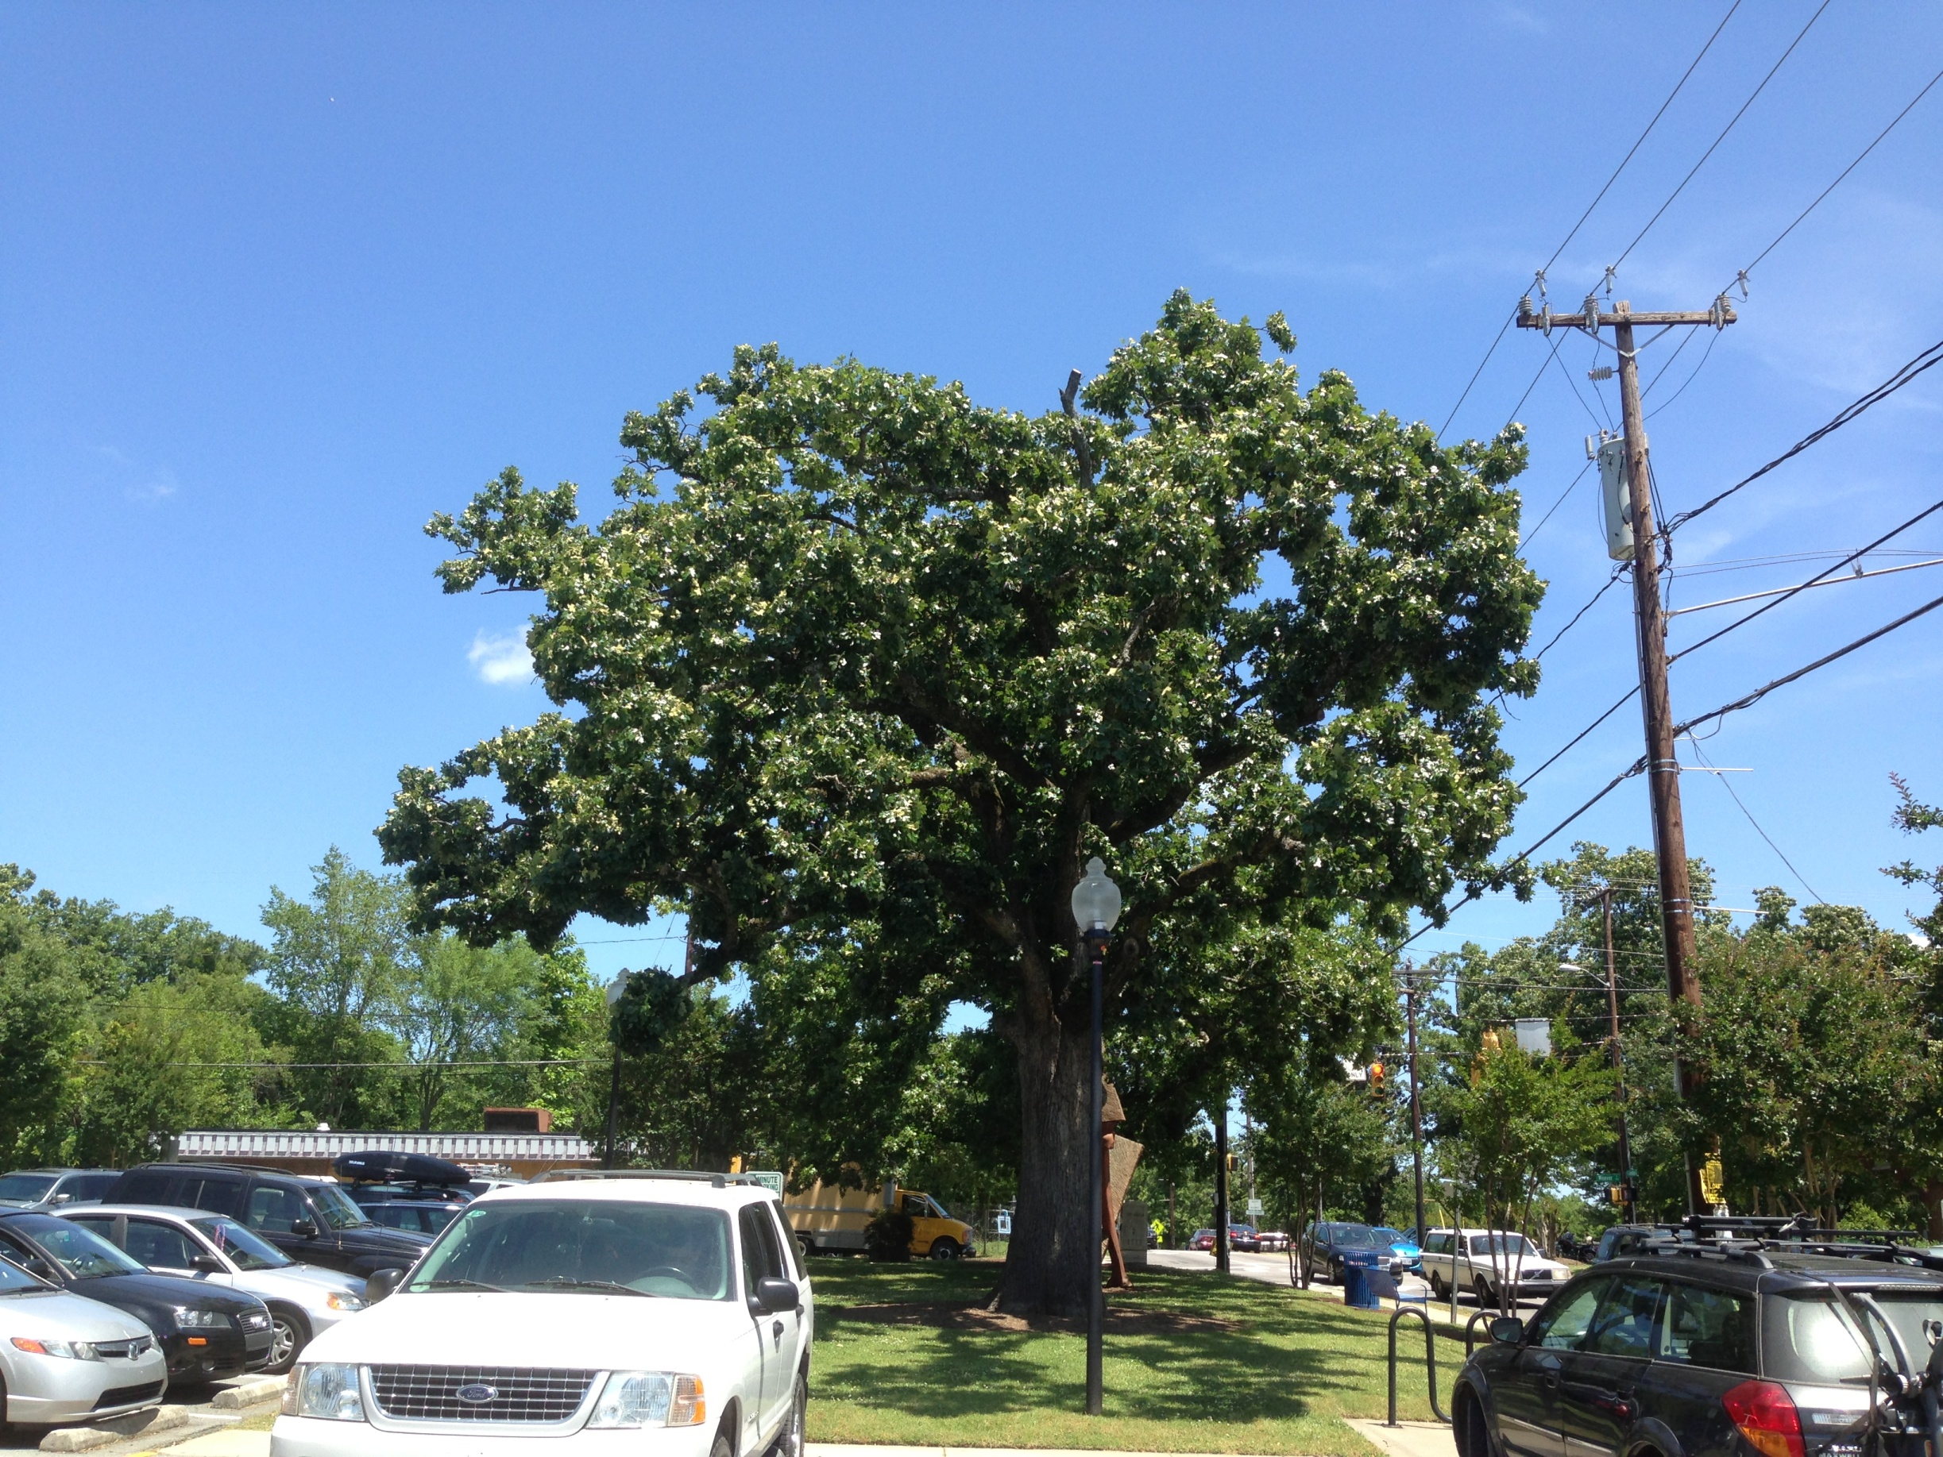
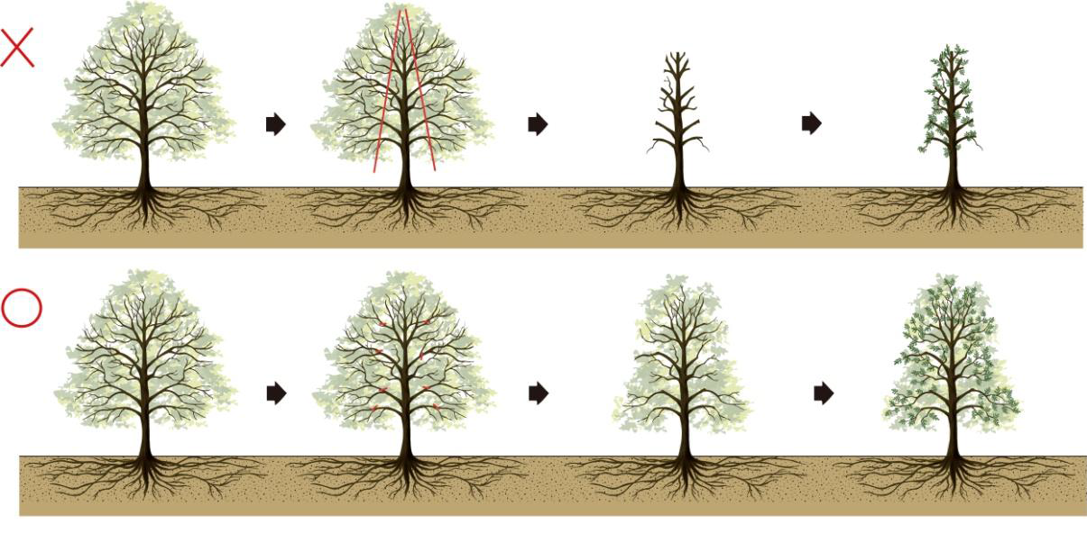
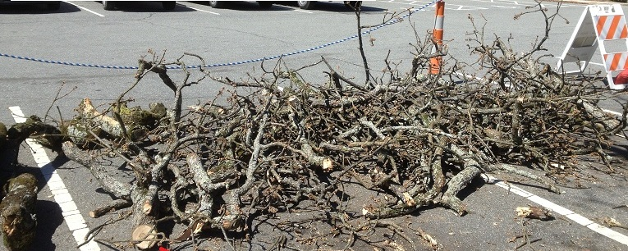
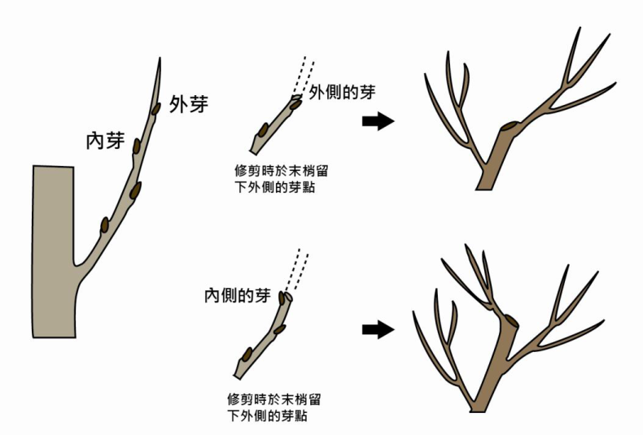
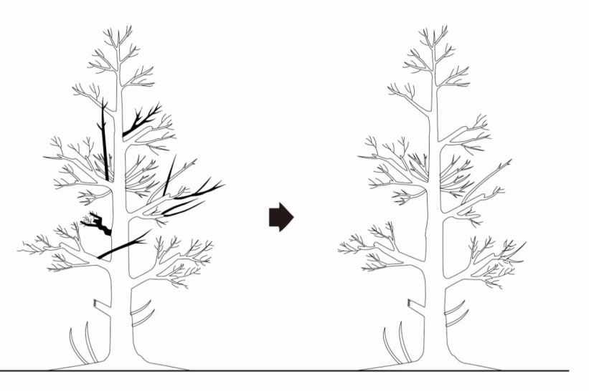


International Standards on Retrenchment Pruning: Comparison and Implementation
Guy Meilleur, Practicing Arborist and Aerial Consultant, HistoricTreeCare.com
Veteran Tree Network, Ancient Tree Forum-US, Society of Municipal Arborists, International Oak Society, Native Tree Society, ISA Board-Certified Master Arborist
ABSTRACT
United Kingdom BS 3998: 2010 Tree Work—Recommendations British Standards Institute, Supplemental Support Systems, Pruning, Soil,
Safety, Wildlife
Informational wording embedded and italicized
Annex on retrenchment is normative (standard). Annexes on laws, decision-making is informative. Downloadable.
Cost: $305USD, $152 BSI member, $59 ‘short version’.
Wording: Mostly ‘should’s, recommendations, some ‘may’s, alternatives, ‘can’s, possible consequences 68 pg.
“Illustrations should be used to communicate…”
March 2013: Condemned Tree
August 2013: Valued Tree
Pruning standards permit more than they prohibit. Positively applied, they put power in an arborist’s arsenal. Europe has a long history with standards and specifications for. the management of trees and landscapes, including retrenchment pruning, the gradual reduction and regeneration of tree crowns. Outer growth is removed, stimulating inner branches to grow the crown downward.
A lower crown lowers risk, often with very low maintenance. Informed by international experience, specified retrenchment pruning can sustain substantial value and benefits from trees with structural constraints . Consistency and reliability in current standards empowers cooperation between cultures, harmonizing the international practice of arboriculture.
OBJECTIVES
Observe how retrenchment pruning is standardized and specified internationally
Identify elements that build usability,
Harmonize current efforts on tree pruning standards,
Globalize consistency in arboricultural standards and practices.
Taichung , Taiwan Pruning Standard
Pruning only. Free download (Mandarin)
Many illustrations, including retrenchment
CRITERIA for COMPARISON
Removal recommended by 4 arborists due to decay. This sentence was found in 13 different reports:
: “Pruning would not lessen the risk to an acceptable level.” Town sought and agreed to a 5th opinion.
Flare care specifications: Remove mulch, soil,. Clear buttress roots by 6-12”. Identify and measure adventitious basal roots . Clean and cauterize bleeding lesions. Trunk drench as specified. Leave drill wounds exposed.
Pruning Specifications: 1. Remove all dead branches >1” diameter.
2. Reduce downward and horizontal parts of overextended branches. Clear the branches below by 2’-4’. Cuts <3” to upright laterals, <8% total foliage
3. Reduce declining leaders 3’-6’. Smallest cuts possible, to vigorous nodes.
Understandable Wording , information for useability?
Available digitally or in print?
Set in the broader industry context, with business contracts, related practices?
Country, Standard, Scope, Year, Usability, Cost
Landscape Performance: Decay and Sprawl
Owner Goals:
Low Risk, Low Maintenance
Arborist Evaluates Goals, Landscape
Arborist + Owner Agree on the Objective
Specified Action Simple + Active:
Retain Remove
Reduce
Clear
Work Completed: Monitor
Germany, ZTV-Baumpflege, Contracts,
Supplemental Support Systems, Root
and Soil Work, Pruning , Construction, 2007
Informational wording embedded and italicized
Appendices for related material. Allied standards for landscaping and construction
Cost: $28 US, downloadable .pdf 66 pages
Wording, in order of emphasis: must, shall, should. Primary audience is the contractor.
Guidance on Regenerative Pruning. Contractor must inspect. “spurs are not permitted…Limbs >10 cm (4”) should not be removed…” Applies to horticulture and forestry.
United States ANSI A300 Tree Care Standard
(Part 1) 2008 Pruning only. 11 separate $20
publications for support, roots, soil work, etc.
No informational wording in body.
Brief appendices for information.
$20, paper, 9 pages (limited wording).
Large subscribers can download.
Wording: shall = requirement, should = recommendation. Primary audience agencies, attorneys, “It is a guide for arborists …A300 (Part 1) Pruning standards provide acceptable industry performance parameters.”
Retrenchment, horticulture, forestry currently excluded
(2014 revision will) “review and incorporate changes in industry standard practices... Harmonization with related industry standards will be considered.”
Harmonization of US with international standards was considered while treating this hollow oak:
July 2014: Callus showing. No sprouts at cuts. Two limbs declining further. Outer crown in very good condition. Adventitious root grew .9mm dia.
REFERENCES
1. BS 3998: 2010 Tree Work—Recommendations British Standards Institute
2. ZTV Baumpflege…German Guidelines for Tree Care www.fll.de/shop 20 Euros for the download
3. Arboriculture: The Integrated Management of Trees, Shrubs and Vines
4. ANSI A300 Tree Care Standard, Part 1 Pruning TCIA
5. Basic Tree Risk Assessment CEU article, Arborist News October 2006, ISA
6. Field Form for Basic Tree Risk Assessment, ISA
7. Tree Morphology, Fay, Neville, Treeworks Environmental Practice, 2011
8. Best Management Practices on Tree Risk Assessment, ISA
9. How Hollow may a Tree be? Wessolly, L. Neue Landschaft 11/96 p. 847-850
10. Risk Assessment Criteria for Branch failure, Goodfellow, John 2009,
11. Ancient and other Veteran Trees: further guidance Lonsdale, ed., 2013
12. Veteran Trees: A Guide to Good Management Read, H. 2000 13. Geholzschnitt: nach den Gesetzen der Natur, Pfisterer, Jochen. 1999
14. VETree Training Manual, Vocational Education and Training on Veteran Trees, 2014
Australia, Pruning of Amenity Trees , 2007
Pruning only, paper only, $79.
All wording is normative (standard), not informational
Appendices for related material. Allied standards for
Soil work, landscaping and construction.
Horticulture, forestry excluded
For more about international tree care standards, case studies using Simple Specs, or
scheduling a Veteran Tree Training in your area:
The Objective drives the specified actions. No steps needed for “type or method of pruning “or “type of cut” . Information is delivered in the specification . Simple process, simple terms, simple specifications.
www.historictreecare.com 01-919-387-7045 historictreecare@gmail.com
Guy Meilleur, ISA BCMA #SO-0284

