Slide 1
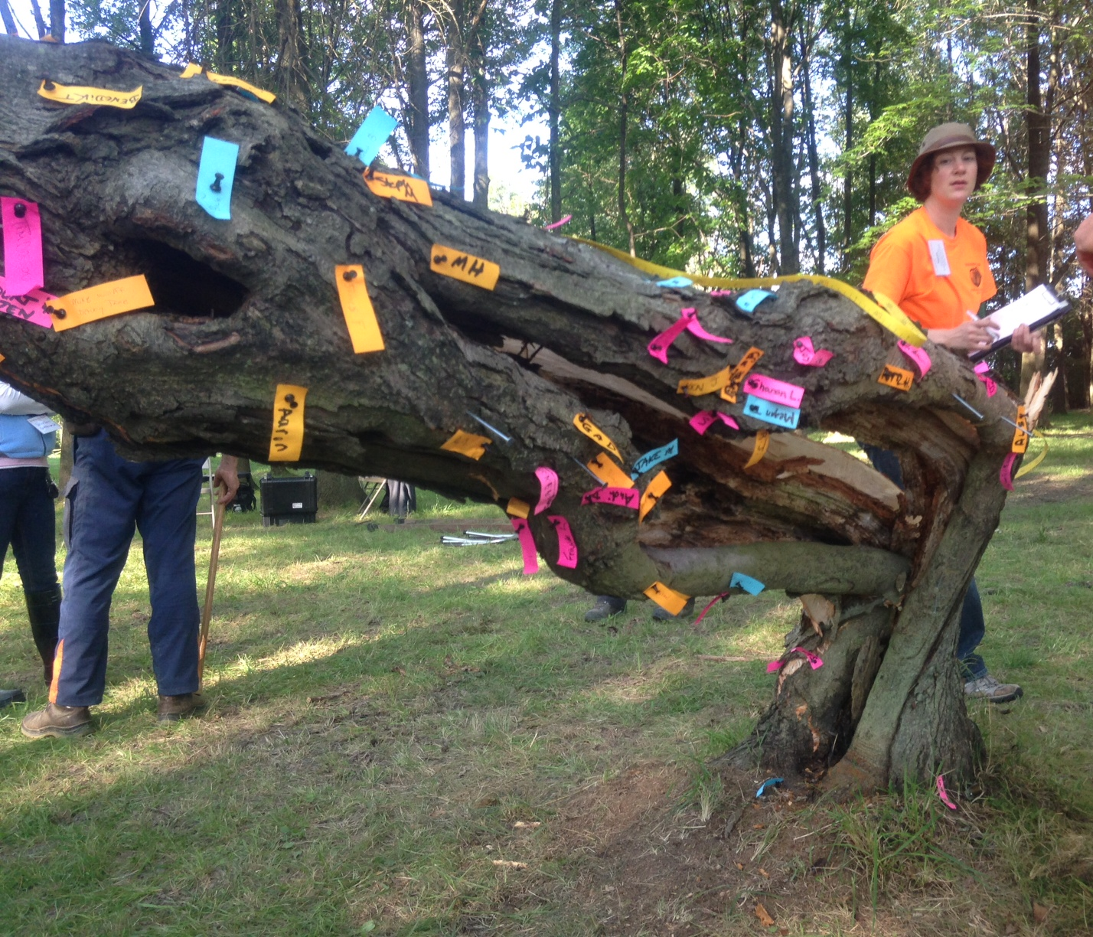
Biomechanics Week 2013
The Wager Tree
40 bets were made on where this hollow, rotten red maple would break.
Over half chose the
hollowest, rottenest location.
Only after the tree fell over did woundwood fibers around the open cavity separate.

